Slide 1

Medical Store-Distributor-Consumer Network
Proposal and Feasibility Presentation Template
Abdulla Iqbal FA17-BSE-030
Armaghan Hassan FA17-BSE-045
Majid Durani FA17-BSE-021
Supervisor: Sir Kashif Nasir
Department of Computer Science
COMSATS University Islamabad, Abbottabad Campus

Slide 2
Agenda of the Presentation
The agenda is to find out the feasibility report of the project (Medical Store-Distributor-Consumer-Network).
Motivation
Introduction
Scope
Functionalities
Proposed Tools/Platform
Feasibility
Schedule
Tasks for 1st Iteration (or 30%)

Slide 3
Motivation
To develop an interactive Website and App
It will allow both companies and retailers to manage their stock
To overcome the medicine shortage problem.
It will make it easier for them to keep track of their inventory and will maintain the data of their buying and selling.
Reduce the chances of buying fake medicines
All this method is all on paper we are digitalizing this all.

Slide 4
Brief Introduction
The Medical Store Distributor Consumer Network (MSDCN) is a medicine stock inventory system which will be used in Medical store and Pharmaceutical companies. This website will store details of medicine purchase and selling. The system will maintain purchases and selling detail w.r.t retailer and company. The system will consist of automatic billing and reporting module. Furthermore, the website will also help the shopkeeper to automatically place the order if the stock is short from the shop.

Slide 5
Scope
Our system will target Medicine market.
The problem with current medicine market is that all the communication, transactions, order placing, and order delivery is based on paperwork and wire transfers which results in delays and no monitoring.
We will provider our own Point of Sale with the website.
Our system will provide online platform for both Medical Stores and Pharmaceutical Companies.
It will allow them to monitor transaction, order details, order delivery status, point of sale details, inventory managements.
Physical Order Delivery will not be covered by this system.

Slide 6
Functionalities
Registration
Point of Sale
Inventory Management
Online E-Com shop
Medicine Shortage Notification
Online Payment
Generate Reports and Bills

Slide 7
Proposed Tools/Platform
Visual Studio Code
Android Studio
Star UML
MS Visio
Laravel Php Framework
Bootstrap

Slide 8

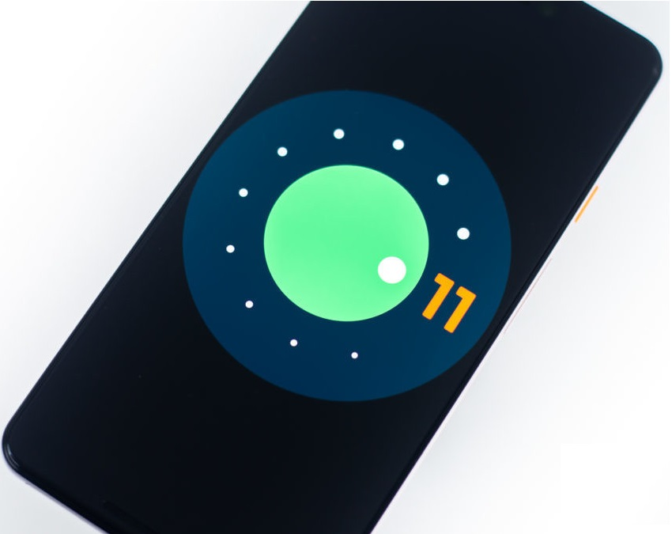
Feasibility
Technical feasibility
All the hardware is available like laptops and cell phones, and technically it is possible to make this project.
3 laptops
3 cell phones
The API’s that will be used are:
Laravel inbuilt Email Verification:
https://laravel.com/docs/7.x/verification
Payment method
https://www.jazzcash.com.pk/jazzcash-for-business/online-payment-gateway/
http://happening.pk/gsmahackathon/apidocument3.pdf

Slide 9
Feasibility
Financial feasibility
The tools which we will be using are free and there is no hardware, so no cost.
The only cost present is of
Web Hosting $15
Android Store Buy-in $10

Slide 10
Feasibility
Resource feasibility
Human resources Such as Team members and useable equipment (Laptops and Cell phones) are available for the project.
Domain and Hosting can easily be bought

Slide 11
Feasibility
Operational feasibility
Website and App developed will be officially released and no ethical problems will occur during development, human recourses will be available after the system has been installed.

Slide 12
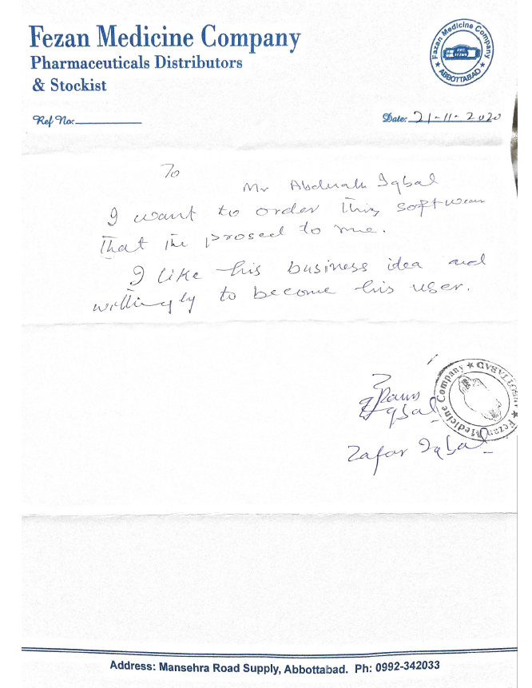
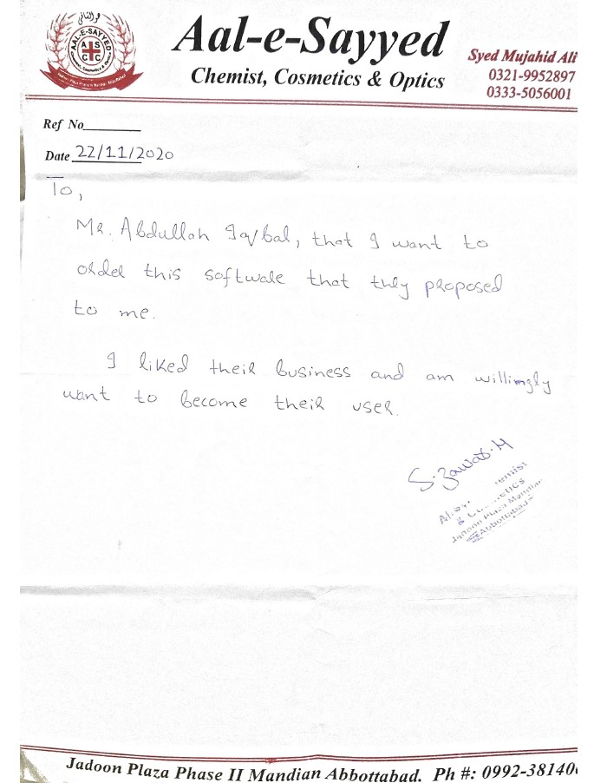

Slide 13
Business Model
Our business will work like a subscription model.
Basic: Point of Sale + Inventory
Premium: Point of sale + app
Gold: Point of sale + App + E-com
We will provide our services in these 3 categories and every package will have a different cost.
Per month billing system.

Slide 14
USERS
Retailer
Point of sale
Inventory Management
Online order placement
Shortage alert
Online payment
Distributor
Inventory Management
Shortage Alert
Online Payment Receive
Online Order Receive
Admin
Verification of License
Technical Support

Slide 15
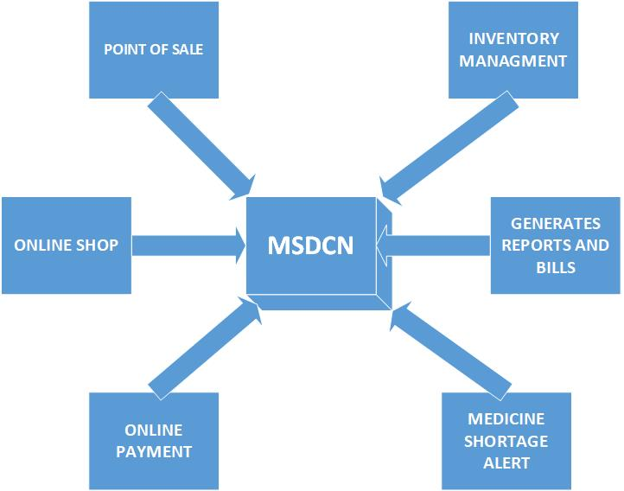
Schedule
Block Diagram

Slide 16
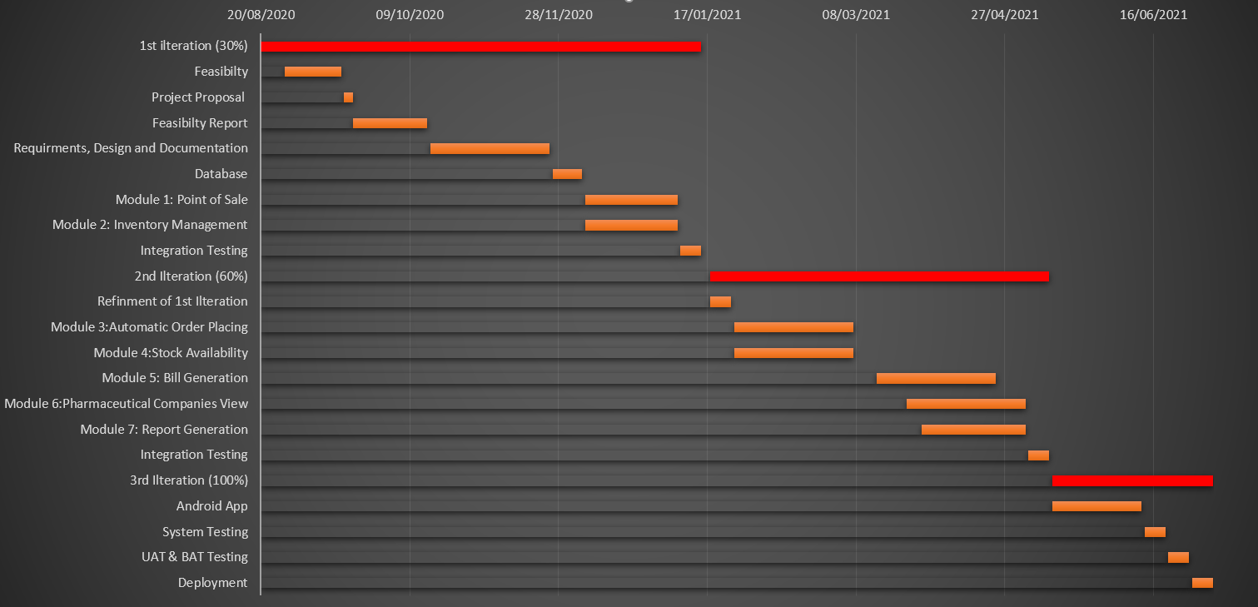
Schedule
Schedule (GANTT Chart)

Slide 17
Tasks for 1st Iteration (or 30%)
Software Requirements Specifications (SRS)
Software Design Specification (SDS)
Database
Back end logic of adding items in inventory
Back end logic of adding items to cart.

Slide 18
Thank You

